Slide 1

IS-201 - Database Part(1) of (2) Chapter 1 - Introduction
DAW MAY THU KYAW
LECTURER
Faculty of Information Science

Slide 2
Outlines
What is a Database Management System
Database-System Applications
Purpose of Database Systems
View of Data
Database Languages
Database Design

Slide 3

Resources
Textbook
Database System Concepts Seventh Edition, by Abraham Silberschatz Henry F. Korth and S. Sudarshan, 2020.
Content Creator:
Daw May Thu Kyaw, Lecturer, University of Computer Studies, Yangon

Slide 4
Introduction
A database management System (DBMS) is a collection of interrelated data and set of programs to access those data.
The collection of data, usually referred to as the database, contains information relevant to an enterprise.
The primary goal of a DBMS is to provide a way to store and retrieve database information that is both convenient and efficient.
Database systems are designed to manage large bodies of information.
Management of date involves both defining structures for storage of information and providing mechanisms for the manipulation of information.
In addition, the database system must ensure the safety of the information stored, despite system crashes or attempts at unauthorized access.

Slide 5
Database System
DBMS contains information about a particular enterprise
Collection of interrelated data
Set of programs to access the data
An environment that is both convenient and efficient to use
Database systems are used to manage collections of data that are:
Highly valuable
Relatively large
Accessed by multiple users and applications, often at the same time.
A modern database system is a complex software system whose task is to manage a large, complex collection of data.
Databases touch all aspects of our lives

Slide 6
Database Applications Examples
Enterprise Information
Sales: customers, products, purchases
Accounting: payments, receipts, assets
Human Resources: Information about employees, salaries, payroll taxes.
Manufacturing: management of production, inventory, orders, supply chain.
Banking and finance
customer information, accounts, loans, and banking transactions.
Credit card transactions
Finance: sales and purchases of financial instruments (e.g., stocks and bonds; storing real-time market data
Universities: registration, grades

Slide 7
Database Applications Examples (Conts)
Airlines: reservations, schedules
Telecommunication: records of calls, texts, and data usage, generating monthly bills, maintaining balances on prepaid calling cards
Web-based services
Online retailers: order tracking, customized recommendations
Online advertisements
Document databases
Navigation systems: For maintaining the locations of varies places of interest along with the exact routes of roads, train systems, buses, etc.

Slide 8
Purpose of Database Systems
Data redundancy and inconsistency: data is stored in multiple file formats resulting induplication of information in different files
Difficulty in accessing data
Need to write a new program to carry out each new task
Data isolation
Multiple files and formats
Integrity problems
Integrity constraints (e.g., account balance > 0) become “buried” in program code rather than being stated explicitly
Hard to add new constraints or change existing ones

Slide 9
Purpose of Database Systems (Conts)
Atomicity of updates
Failures may leave database in an inconsistent state with partial updates carried out
Example: Transfer of funds from one account to another should either complete or not happen at all
Concurrent access by multiple users
Concurrent access needed for performance
Uncontrolled concurrent accesses can lead to inconsistencies
Ex: Two people reading a balance (say 100) and updating it by withdrawing money (say 50 each) at the same time
Security problems
Hard to provide user access to some, but not all, data
Database systems offer solutions to all the above problems

Slide 10
University Database Example
In this text we will be using a university database to illustrate all the concepts
Data consists of information about:
Students
Instructors
Classes
Application program examples:
Add new students, instructors, and courses
Register students for courses, and generate class rosters
Assign grades to students, compute grade point averages (GPA) and generate transcripts

Slide 11
View of Data
A database system is a collection of interrelated data and a set of programs that allow users to access and modify these data.
A major purpose of a database system is to provide users with an abstract view of the data.
Data models
A collection of conceptual tools for describing data, data relationships, data semantics, and consistency constraints.
Data abstraction
Hide the complexity of data structures to represent data in the database from users through several levels of data abstraction.

Slide 12
Data Models
A collection of tools for describing
Data
Data relationships
Data semantics
Data constraints
Relational model
Entity-Relationship data model (mainly for database design)
Object-based data models (Object-oriented and Object-relational)
Semi-structured data model (XML)
Other older models:
Network model
Hierarchical model

Slide 13
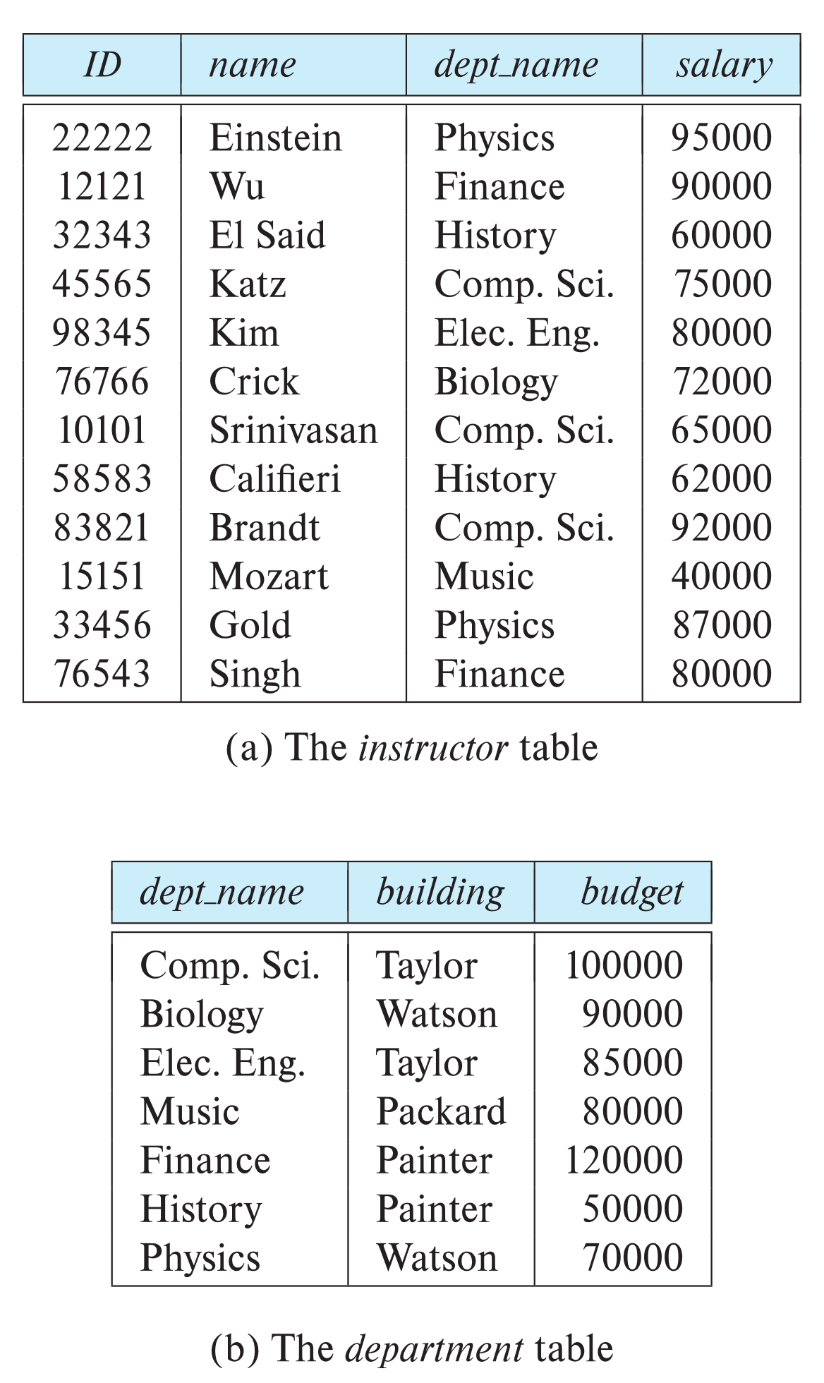

Relational Model
All the data is stored in various tables.
Example of tabular data in the relational model
Columns
Rows
Ted Codd Turing Award 1981

Slide 14
A Sample Relational Database

Slide 15
Levels of Abstraction
Physical level: describes how a record (e.g., instructor) is stored.
Logical level: describes data stored in database, and the relationships among the data.
type instructor = record
ID:string; name:string; dept_name:string; salary : integer;
end;
View level: application programs hide details of data types. Views can also hide information (such as an employee’s salary) for security purposes.

Slide 16
View of Data
An architecture for a database system

Slide 17
Instances and Schemas
Database change over time as information is inserted and deleted.
The collection of information stored in the database at a particular moment is called an instances of the database.
The overall design of the database is called the database schemas.
Similar to types and variables in programming languages
Database systems have several schemas, partitioned according to the level of abstraction.
Logical Schema – the overall logical structure of the database
Example: The database consists of information about a set of customers and accounts in a bank and the relationship between them
Analogous to type information of a variable in a program
Physical schema – the overall physical structure of the database
Instance – the actual content of the database at a particular point in time
Analogous to the value of a variable

Slide 18
Physical Data Independence
Physical Data Independence – the ability to modify the physical schema without changing the logical schema
Applications depend on the logical schema
In general, the interfaces between the various levels and components should be well defined so that changes in some parts do not seriously influence others.

Slide 19
Physical Data Independence
Specification notation for defining the database schema
Example: create table instructor ( ID char(5), name varchar(20), dept_name varchar(20), salary numeric(8,2))
DDL compiler generates a set of table templates stored in a data dictionary
Data dictionary contains metadata (i.e., data about data)
Database schema
Integrity constraints
Primary key (ID uniquely identifies instructors)
Authorization
Who can access what

Slide 20
Data Manipulation Language (DML)
Language for accessing and updating the data organized by the appropriate data model
DML also known as query language
There are basically two types of data-manipulation language
Procedural DML -- require a user to specify what data are needed and how to get those data.
Declarative DML -- require a user to specify what data are needed without specifying how to get those data.
Declarative DMLs are usually easier to learn and use than are procedural DMLs.
Declarative DMLs are also referred to as non-procedural DMLs
The portion of a DML that involves information retrieval is called a query language. Integrity constraints

Slide 21
SQL Query Language
SQL query language is nonprocedural. A query takes as input several tables (possibly only one) and always returns a single table.
Example to find all instructors in Comp. Sci. dept
select name from instructor where dept_name = 'Comp. Sci.'
SQL is NOT a Turing machine equivalent language
To be able to compute complex functions SQL is usually embedded in some higher-level language
Application programs generally access databases through one of
Language extensions to allow embedded SQL
Application program interface (e.g., ODBC/JDBC) which allow SQL queries to be sent to a database

Slide 22
Database Access from Application Program
Non-procedural query languages such as SQL are not as powerful as a universal Turing machine.
SQL does not support actions such as input from users, output to displays, or communication over the network.
Such computations and actions must be written in a host language, such as C/C++, Java or Python, with embedded SQL queries that access the data in the database.
Application programs -- are programs that are used to interact with the database in this fashion.

Slide 23
Database Design
The process of designing the general structure of the database:
Logical Design – Deciding on the database schema. Database design requires that we find a “good” collection of relation schemas.
Business decision – What attributes should we record in the database?
Computer Science decision – What relation schemas should we have and how should the attributes be distributed among the various relation schemas?
Physical Design – Deciding on the physical layout of the database

Slide 24
Next Lecture
Database Engine_ will be explained.

